Slide 1
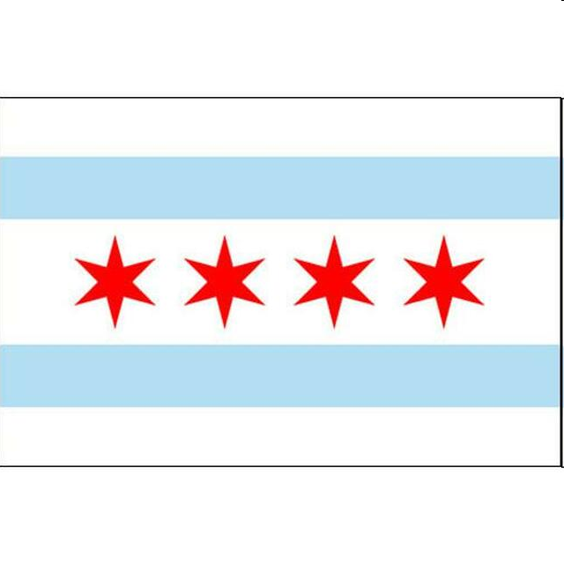



Toronto Substitute Filming Locations for
The Chicago Dramas

Slide 2
Budget Cuts Hit The Chicago Dramas
William F. Fox Productions produces the popular Chicago-based TV shows: Chicago Crime, Chicago Hospital and Chicago Emergency Response
These shows, known as “The Chicago Dramas” air on the American National Broadcasting Network. The network has just informed WF Fox that the budget for the next season’s production will be cut by 20%.
This budget cut will require WF Fox to move production of many scenes to Toronto to take advantage of lower production costs and Canadian and Ontario Government production subsidies.
“The Chicago Dramas” are known for their Chicago authenticity so care needs to be taken to identify substitute locations on a short notice.
Data Analysis firm Location Dynamics has been called to narrow and guide the efforts of the WF Fox location scouting teams.
The teams will conduct 3 separate analyses
  Streetscape/Architectural Analysis to ensure the new locations match Chicago visually.
  Demographic Analysis to ensure the new locations match Chicago in terms of the ethic, age and income characteristics.
  Amenity Analysis to try to match up the types of establishments with Chicago.
This report will focus on the Amenity Analysis.

Slide 3
Data Acquistion and Cleaning
Chicago data is based on the 77 community areas of Chicago with Latitude and Longitude obtained from Wikipedia.
Toronto data is based on Postal Coding obtained from Wikipedia.
Amenities data is obtained via Foursquare.
Toronto Postal Codes with Borough and Neighborhood data limited to Toronto proper.
Data combined with Postal Codes and Community Areas mapped into field Area_ID.
Dataset is 115 rows and 305 columns.

Slide 4
Data Analysis
The objective of the analysis is to match Chicago Community Areas with Toronto Areas with similar amenities.
This will be accomplished using K-Means Clustering.
The combined Toronto/Chicago dataset is divided into 12 clusters using K-means.
6 Community Areas are of particular interest as they are the settings for episodes of the new season:
The data for the most critical 6 community areas was checked against Toronto Areas: Near North Side, Englewood, West Town, Humbolt Park, Lincoln Park and Archer Heights.
Archer Heights, West Town and Humbolt Park areas were clustered with only 3 other Toronto Postal Codes.

Slide 5
Data Analysis (cont.)
The other 3 areas mapped to Cluster 5 which consisted of the bulk (30 of 38) Toronto Postal Code areas.
A second round of clustering was used to narrow this down.
The combined Toronto/Chicago dataset is divided into 12 clusters using K-means.
The results of this placed the Lincoln Park and Near North Was clustered in a cluster with the M4K Postal Code in Toronto.
The remaining Englewood Community Area was isolated into its own cluster.
The Englewood Community is an economically distressed, high violent crime neighborhood that may have no close analog in Toronto.

Slide 6
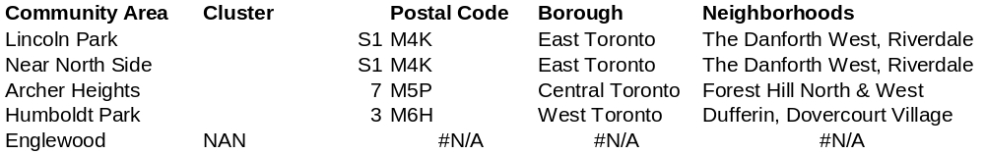
Conclusion and Future Directions
The analysis projected that potential matches for the key community areas are:
This information should be combined with Streetscape and Demographic analyses to provide a short list for location scouts to use on their coming trip to Toronto.
Future analysis should be improved by condensing the number of Amenities:
  Combine Restaurants into broader categories
  Eliminate some irrelevant categories (Hockey Rinks)
  Combine other similar types (Gym, Gym/Fitness Center)

